Slide 1
Sovereign Risk Modeling
Capstone Project for Metis Data Science Bootcamp: Winter 2021 Cohort
By: Gabriel Vieira Equitz
Presented: March 24, 2021

Slide 2

About Author: Gabriel Equitz
BS in Computer Science, San Francisco State University, 2019
Metis Data Science Bootcamp (2021 Winter Cohort: 1/4/21-3/26/21)
Economics-related Final Project

Slide 3

Intro to Sovereign Risk
Governments of countries borrow money, mainly issuing bonds.
The bonds are sold to investors.
Associated with each bond there is an interest rate, which is paid periodically, with the principal paid after a certain number of years.

Slide 4
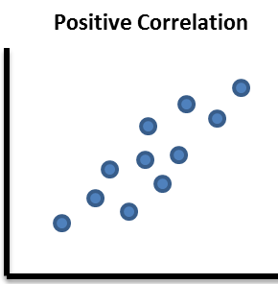
Advice to Bond Buyers
Some of these countries fail to pay back, and go into Sovereign Default
- The larger the probability of default, the the larger the interest rate is expected to be.
Interest rate
Probability of default

Slide 5
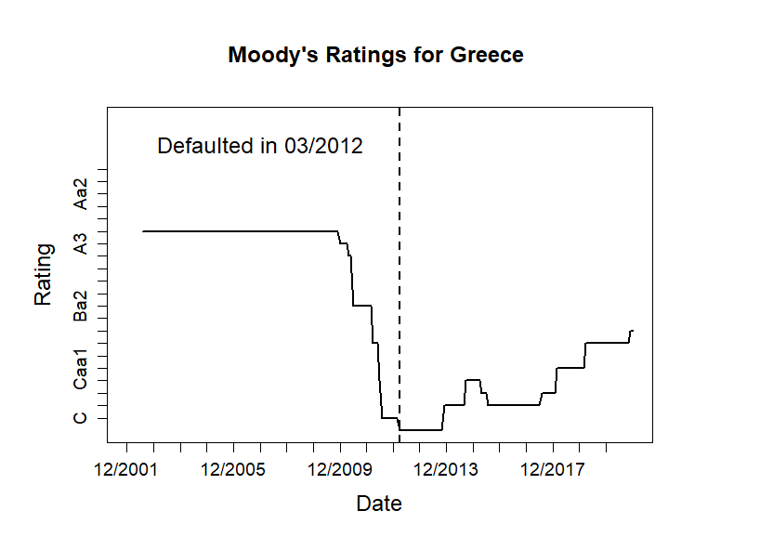

Case Study
Investor services have made poor predictions in the past, on multi-billion dollar bonds
Investment grade, then junk
Notes:
Moody’s classified Greek bonds as investment grade for a long time, and only changed to worse “junk” status shortly before Greece defaulted

Slide 6

Why Make This Model?
Large corporations like such as Moody’s and S&P make similar predictions.
However, there is a distinct lack of free, accessible models on Sovereign Default.
None have free web apps hosted.

Slide 7

What Affects Sovereign Risk?
Variables that determine probability of default are macroeconomic quantities, such as GDP per capita, etc.
Some defaults are not explained by macroeconomics, because some countries default for political reasons (e.g. Ecuador, 2008)

Slide 8
Purpose of Model
Target: Find the probability that a country will default on its debt in the next years.
Web app allows the user to change the model independent variable values or to use the IMF predictions to calculate the new probability of default.

Slide 9
Data Description
CSV files include:
Economic data from IMF (1980-2020)
IMF Projections for 2021-2025
Data of all Sovereign Defaults and Restructurings* compiled by Professor Christoph Trebesch, Kiel University.
* Restructuring is counted the same as Default for our purposes

Slide 10



Model Information
Algorithms: XGBoost in the web app (only want user to see best model)
Metrics: Precision, Recall, AUC (unbalanced dataset, Accuracy is less important)

Slide 11
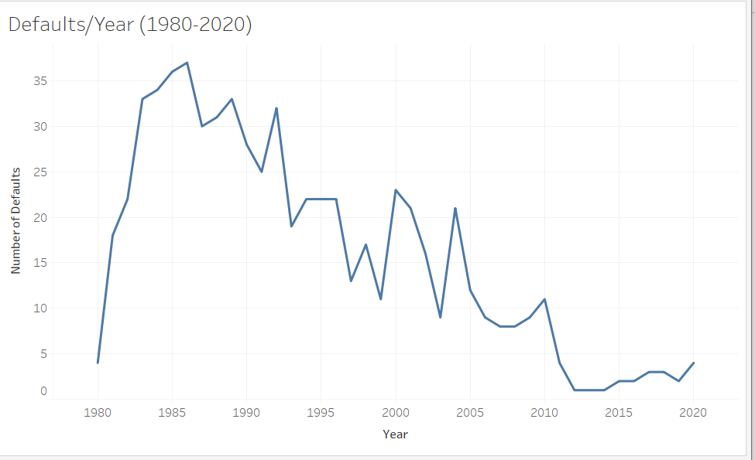
EDA
After preprocessing, features include: GDP per Capita, Unemployment, Export, Import, etc.
Merging adds Sovereign Default and Restructuring data to anchor IMF dataset (1980-2020).
EDA: Number of defaults/year
(20th century > 21st century)

Slide 12
EDA: Null values
The macroeconomic data starts in 1980. The model uses the median value of the geographic region to fill out the missing data.
Geographic regions (based on World Bank classification) are:
Americas | Asia
Europe | Africa
Scandinavia | Latin America

Slide 13


Correlations between Features and Probability of Default (PD)
Positive (+)
Debt over GDP
Annual Inflation
Unemployment Rate
Negative (-)
GDP per Capita
Change in Imports
Change in Export
Gov Revenue/GDP
Gov Expenditure/ GDP
Gov Lending minus Borrowing
Exports minus Imports
Share of the World GDP
Notes:
- GDP per Capita
- Change in Imports
- Change in Export
- Government Revenue/GDP

Slide 14
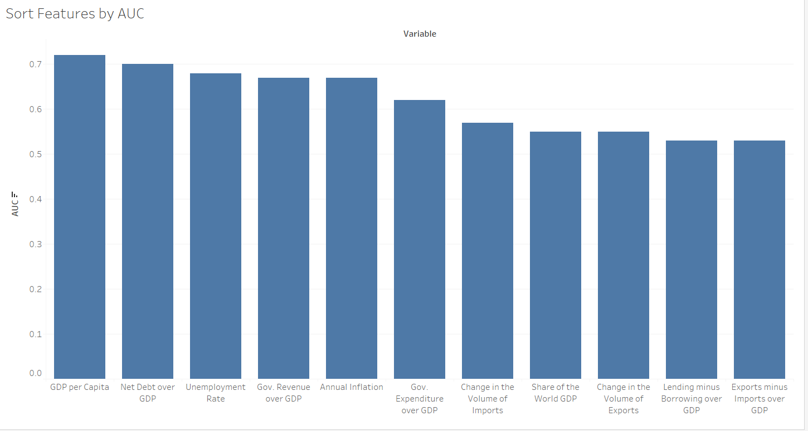
Findings: Biggest Predictor
Richer countries (higher GDP per capita) are less likely to default. It is important to keep debt low.
Importance of each variables by AUC (Predictive power)

Slide 15
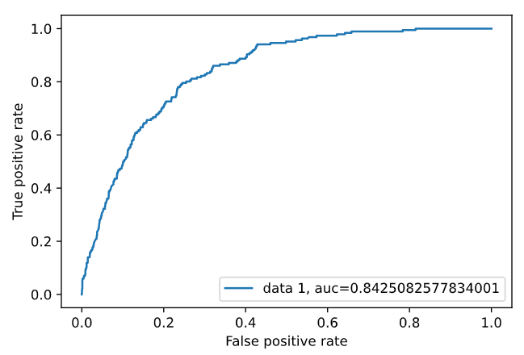
Results
XGBoost
AUC = 0.84
Precision = 0.43
Recall = 0.12

Slide 16
Error Types
False Positive (+)
Model falsely predicts sovereign default where there is none.
False Negative (-)
Model falsely predicts no sovereign default where there is default.
False Negatives are more concerning, as investors stand to lose more money from holding bonds of a country that defaults than failing to invest in a country that doesn’t default

Slide 17
Confusion Matrix Results
The model predicts well the countries that do not default, which is important for interest rate evaluations.
It missed a greater number of countries that defaults.
Precision = 0.43 Recall = 0.12
Errors are reasonably large as macroeconomics does not explain all defaults.
 | Predicted No Default | Predicted Yes Default
Actual No Default | 2265 | 29
Actual Yes Default | 164 | 22

Slide 18
Web App
Made w/ Streamlit
Host on Heroku
Choose Country, Year, Model
Adjust features (by %)
User can change % values based on model or use IMF predictions for years 2021-2025

Slide 19
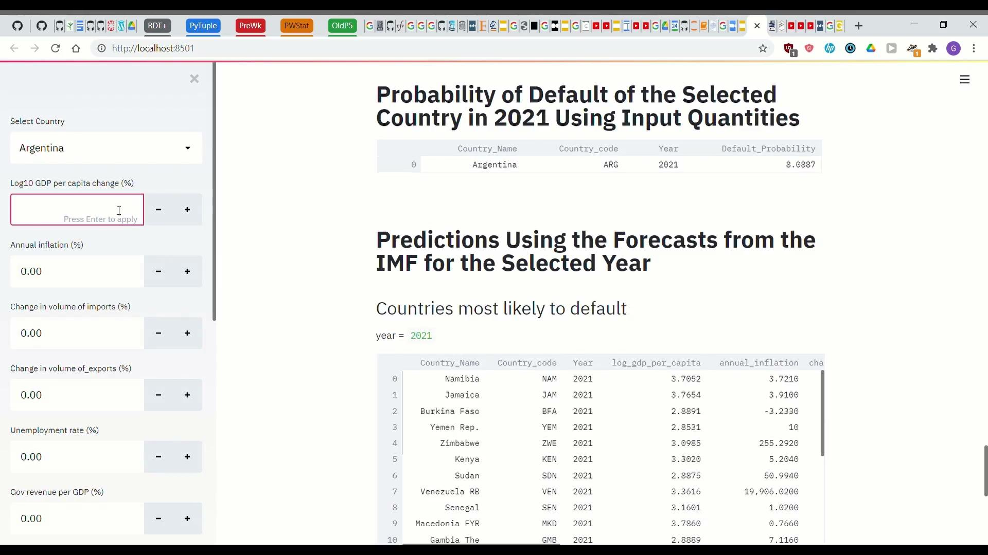
App Demonstration

Slide 20
Model Advantages
Web app
It is open source, contrary to Moody’s and S&P models.
Warn investors of the risk of default when investing in Sovereign bonds.

Slide 21
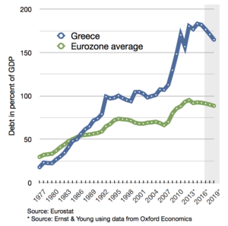


Recommendations Correlated with Avoiding Sovereign Default
Keeping debt low as % of GDP (unlike Greece)
Increasing trade (both imports and exports)
Keeping balanced budget

Slide 22
Future Potential
More frequent data (monthly > quarterly > annual)
Accurate/complete 20th century data
Try to use paid data, such as country reserves and political risk measures

Slide 23

Thank You for Watching

Slide 24
Appendix: Gif of Demo
Showed video as I know how to pause & start it

Slide 25
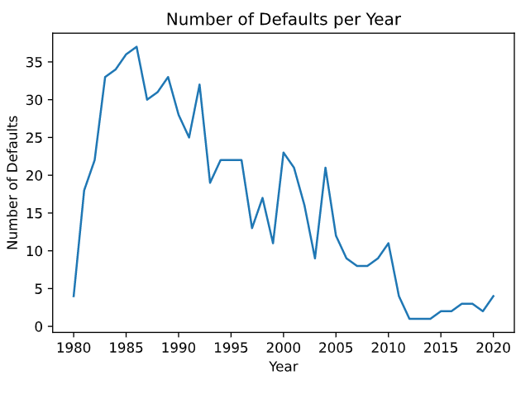
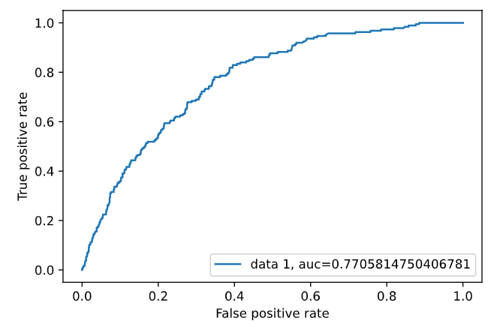
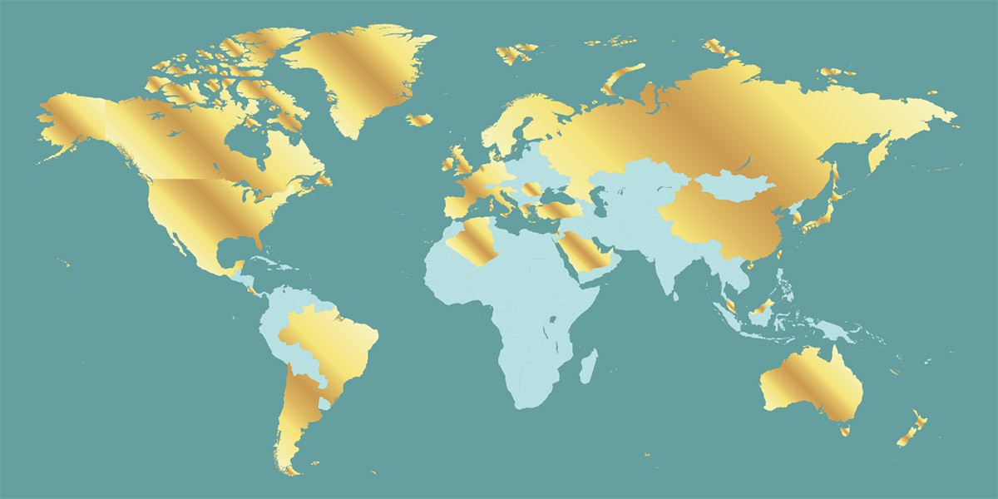
Appendix 2

